Slide 1
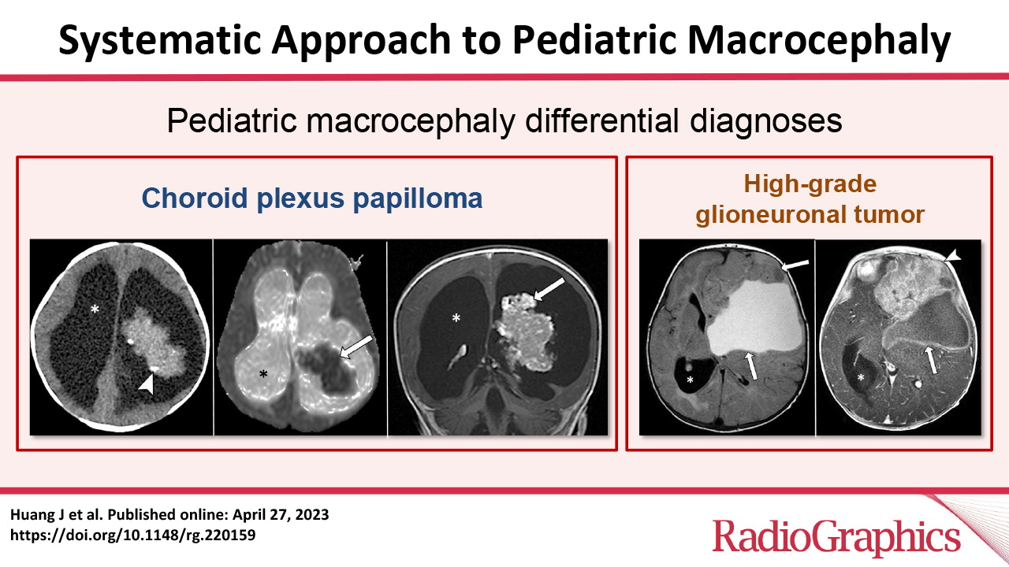

Huang J. Published Online: April 27, 2023
https://doi.org/10.1148/rg.220159

